Slide 1

Personalization and Profile
Comparative Analysis
Liz Lantz
liz.lantz@adhocteam.us
December 2021

Slide 2
Background
Through the course of working on improving the logged-in experience for Veterans, we've identified an opportunity to expand our knowledge on best practices in personalized and authenticated experiences. We frequently solicit screenshots and log into our own accounts to learn from other sites, but haven't formalized any documentation around this.
The goal of this comparative analysis was to answer specific research questions and create a knowledge base of authenticated experiences to share with our team, especially those who are new to this field of user experience.
We want it to be clear that moving forward in these findings, we're referring to personalization not customization. What's the difference? We're glad you asked.
Notes:
We conducted a comparative analysis of sites in government, banking, student loan, and insurance industries since they serve as a good model for the VA.gov use cases. We also included a few sites outside of these sectors since we've heard Veterans mention them repeatedly in research studies. The scope of this research was limited to desktop and mobile versions of sites (not apps). We used our own accounts to log in when possible, and otherwise solicited screenshots from colleagues. To learn about GOV.uk's account experience, we conducted a semi-structured interview with a Senior UX Designer on their Account Experience team.

Slide 3
Customization is done by the user. Personalization is done by the technology.

Slide 4
Research goals
Get a sense for differences in personalized experiences for civic services compared to the private sector
Understand content and language commonly used in a logged-in state
Compare aspects of the VA.gov authenticated experience to the logged-in state of other sites
Learn how sites encourage profile completeness

Slide 5
Research questions
Methodology
What is different about personalization of civic services compared to the private sector (banking, insurance)?
What information about users do sites commonly show in a logged-in state?
How do the conventions we see align with what we're doing on VA.gov?
How do sites encourage profile completeness?
How do sites handle removing/deleting profile information?
How do our Profile nav/section labels align with other sites?
What are other governments doing?

Slide 6

How this research maps to the Veteran journey
Personalization and profile comparative analysis | December 2021
Getting out
Starting up
Taking care of myself
Putting down roots
Reinventing myself
Retiring
Aging
Dying
Reinventing myself
Retiring
Aging
Dying
Joining
Serving
Getting out
Starting up
Taking care of myself
Putting down roots
For a fully detailed Veteran journey, go to https://github.com/department-of-veterans-affairs/va.gov-team/blob/master/platform/design/va-product-journey-maps/Veteran%20Journey%20Map.pdf
Serving and separation
Living civilian life
Retiring and aging

Slide 7
OCTO-DE goals that this research supports
Personalization and profile comparative analysis | December 2021
Supported
Not supported
Veterans and their families can apply for all benefits online
Veterans and their families can find a single, authoritative source of information
Veterans and their families trust the security, accuracy, and relevancy of VA.gov
Veterans can manage their health services online
VFS teams can build and deploy high-quality products for Veterans on the Platform
Logged-in users have a personalized experience, with relevant and time-saving features
Logged-in users can update their personal information easily and instantly
Logged-in users can easily track applications, claims, or appeals online
Completion rate of online transactions
Percent of applications submitted online (vs. paper)
Veteran satisfaction with VA.gov
Benefit use and enrollment, across all business lines
Benefit value (in $) delivered from online applications or transactions
Number of VA.gov users as a function of total Veteran population
Usage of digital, self-service tools
Measures to increase
Time to successful complete and submit online transactions
Time to process online applications (vs. paper)
Call center volume, wait time, and time to resolution
Time from online benefit discovery to benefit delivery
Measures to decrease

Slide 8
Reviewed websites
Methodology
We first planned our research by categories and tasks we wanted to evaluate. Then, we identified sites that made sense to look at based on those groupings:
Manage benefits, claims (view / history) CareFirst Blue Cross Blue Shield State Farm USAA Healthcare.gov | Payments, transactions (view / history) Bank of America / Merrill Lynch Fidelity Investments Chase Citicards Federal Student Aid
Government USA Jobs / Login.gov Global Entry GOV.uk | Personalization, identity* Google Reddit Facebook * In multiple user interviews, Veterans have stated that they use or reference these sites

Slide 9
Research Findings

Slide 10
Key findings
Personalization and profile comparative analysis | December 2021
1. Personalization 1.1 Both civic and private personalized services seek to establish a sense of trust and familiarity. 1.2 There are key differences in how private sector and civic services provide personalization. 1.3 There are 3 common personalized items shown in a logged-in state. 1.4 One difference in the authenticated experience (AE) on VA.gov compared to other sites is the logged-in homepage. 1.5 Another key difference in the AE on VA.gov compared to other sites: the information architecture. 1.6 There isn't a clear best practice or trend for using "My" or "Your" in a personalized experience. 2. Profile 2.1 Interrupt modals and notifications are common approaches to encourage people to complete their profile information. 2.2 Most sites don't allow people to remove primary contact information from their profile. 2.3 The sections of the VA.gov profile are well aligned with other sites.
3. GOV.UK
3.1 GOV.UK is in early stages of personalized user experience.

Slide 11
1. Personalization

Slide 12
Both civic and private personalized services seek to establish a sense of trust and familiarity.
Research Findings
They build a sense of knowing the user's needs and motivations by:
Reflecting known information about a user, such as their name, recent activity, and an overview of their accounts or items in-progress.
Surfacing tailored recommendations, as well as relevant content and tasks. Examples include:
Offering the ability to set an alert or notification for an important task.
Recommending relevant services to complement something the user is already engaging with.

Slide 13
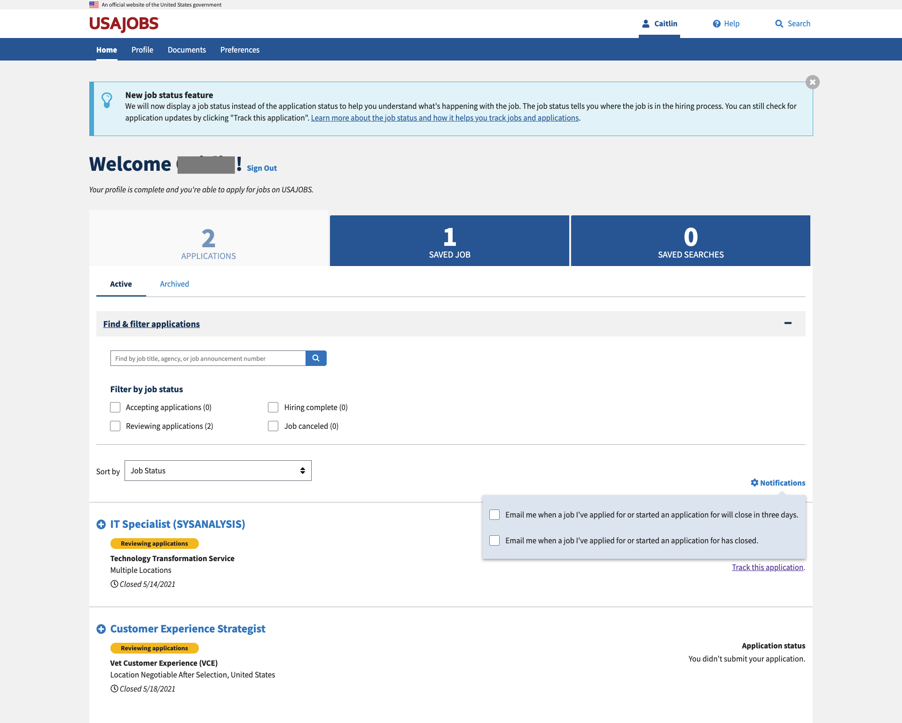
USA Jobs adds the user's first name (removed for privacy) to their navigation and uses a personalized welcome message as their page heading.
Their landing page has a tabbed interface focused on content specific to the user, and prioritizes in-progress applications by defaulting to having that tab open. They also provide easy access to user-defined saved jobs and searches and build trust with the user by offering notifications about important in-progress items.

Slide 14
There are key differences in how private sector and civic services provide personalization.
Research Findings
Private Sector | Civic Services
One-to-one marketing Includes retargeting users with ads or providing recommendations on similar products based on what they’ve already looked at. Can have a "creepy" factor Dedicated real estate on web pages for marketing and services, such as reward programs and special offers. More robust options for managing personal information such as the ability to add multiple addresses, phone numbers, account nicknames, etc. | The variety of touchpoints across agencies in the government can make integration challenging and cause a lack of cross-departmental links and access points. Typically face more significant security and technology constraints than the private sector. Take a basic approach to personalization that reflected 2-3 personalized items (recent activity was most common) upon logging in, compared to 4-5 items on private sector sites. A focus on only 1-2 primary tasks. This makes sense given that the sites typically provide specific civic services that users cannot receive elsewhere.

Slide 15
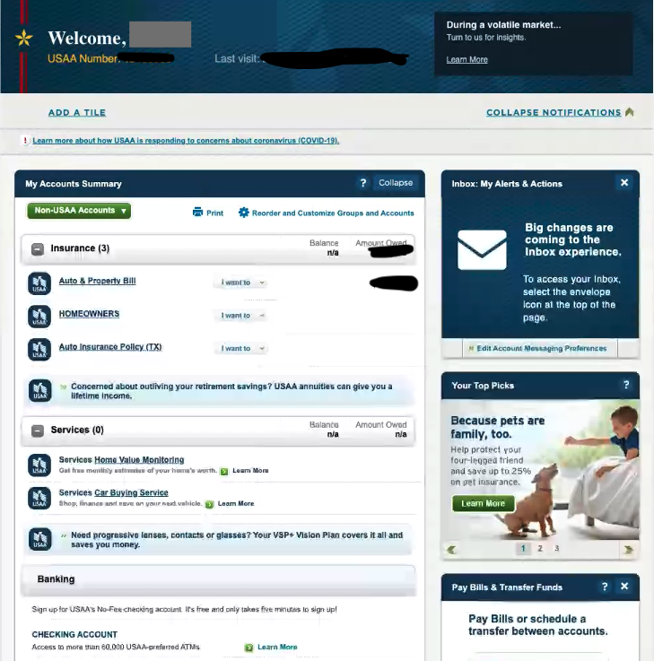
Example: Private sector site
Research Findings
On their dashboard, USAA:
Gives customers the ability to customize their view (add a tile, reorder and customize)
Dedicates space for marketing in the sidebar
Serves up suggested products within the account summary in the main content area of the page.

Slide 16
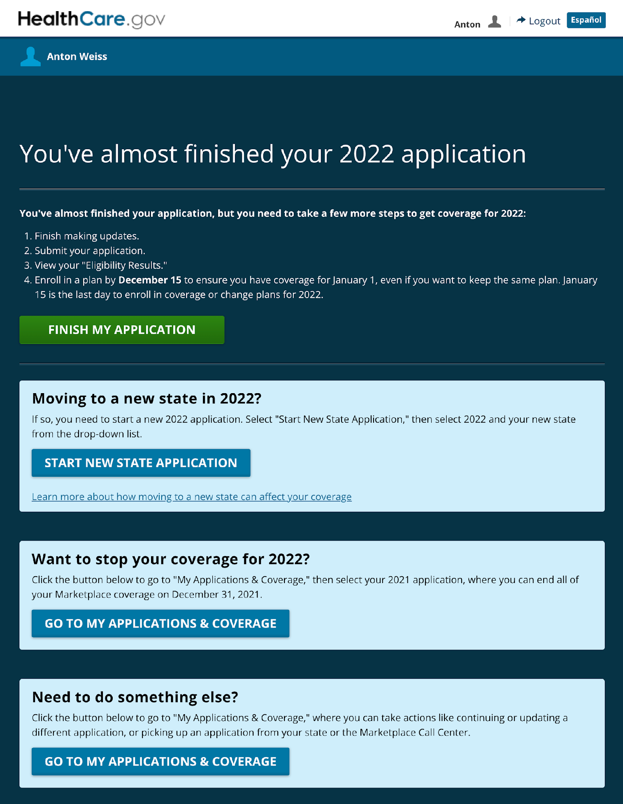
Example: Civic service site
Research Findings
Healthcare.gov focuses the user on the primary task of completing their application in progress immediately after logging in. As a secondary focus, other important applications are surfaced to make it easy for the user to find.

Slide 17
There are 3 common personalized items shown in a logged-in state.
Research Findings
Personalized info | # of sites (of 15)
First name | 10
Alerts / notifications | 8
Overview of accounts | 9
Member id | 4
Greeting (e.g. Welcome) | 4
Recent activity or status | 4
Transactions | 3
Earned rewards | 3
Group number | 2
Custom feed | 2
Recommendations | 2
Enrollment date | 2
Last name | 2
User name | 1
Membership level | 1
Email address | 1
Custom ads | 1
Language preference | 1
Groups | 1
Additional user settings to further personalize | 1
Across the sites we reviewed, the user's first name, account summary and action items/notifications were displayed on a user's logged-in homepage to create a sense of personalization.
We counted 20 points of personalization in total, but most were one-offs and not common across sites.

Slide 18
One difference in the authenticated experience (AE) on VA.gov compared to other sites is the logged-in homepage.
Research Findings
Almost every site (Google being the only exception) we visited had an authenticated homepage with personalized content upon logging in, which was very different from the unauthenticated homepage.
The authenticated homepage on these sites was very similar to My VA:
Focused on the user's account
Provide direct access and to in-progress tasks
Surfacing other relevant, helpful links.

Slide 19
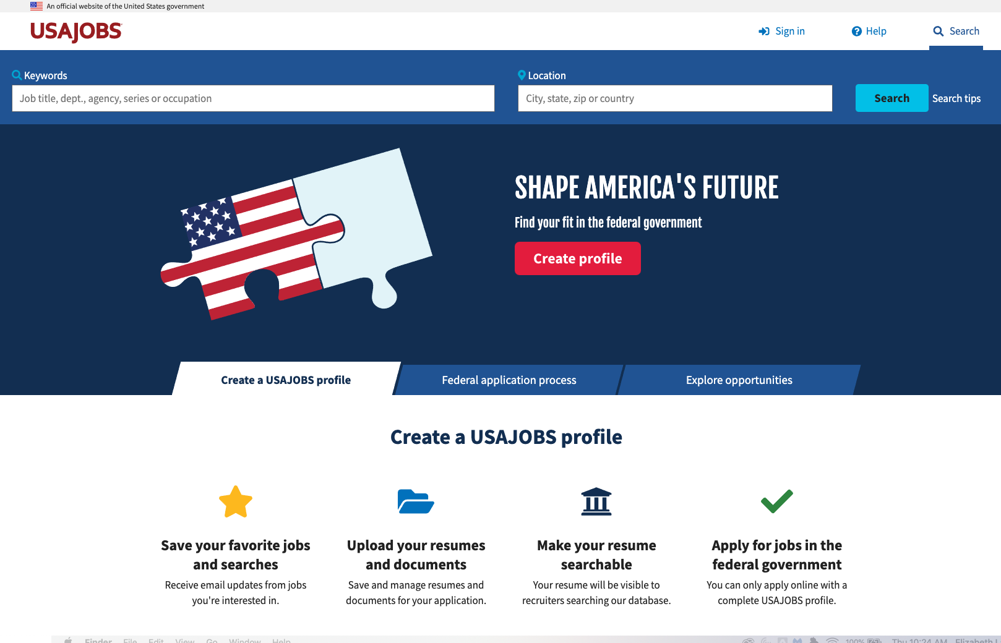
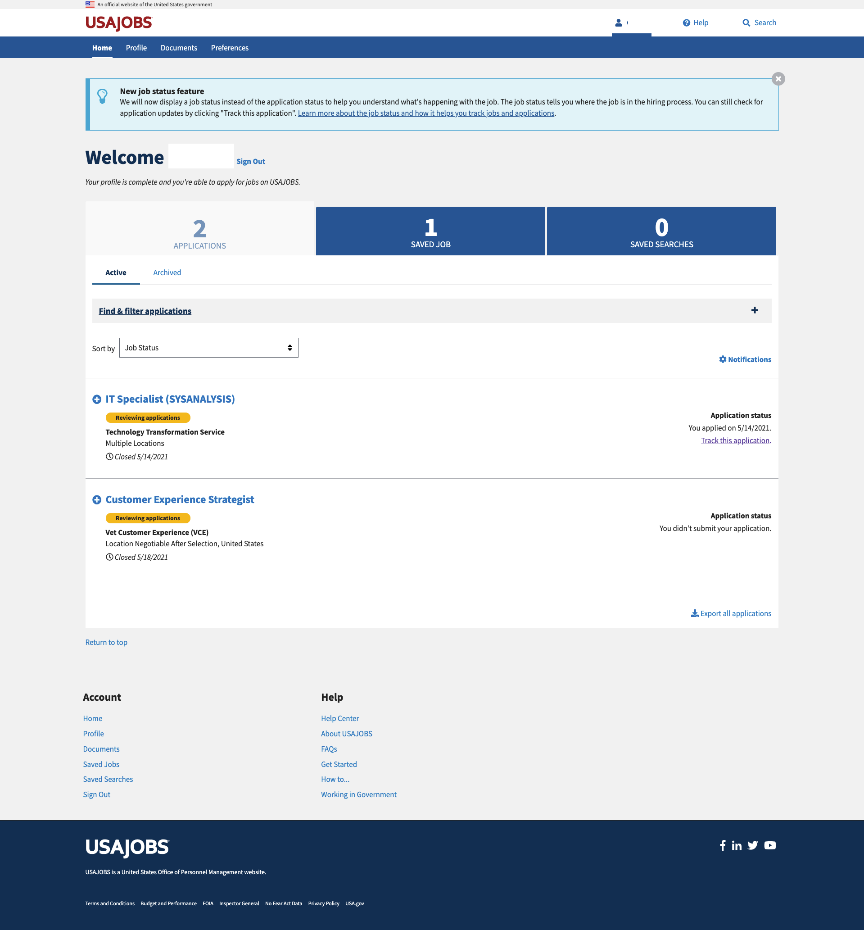
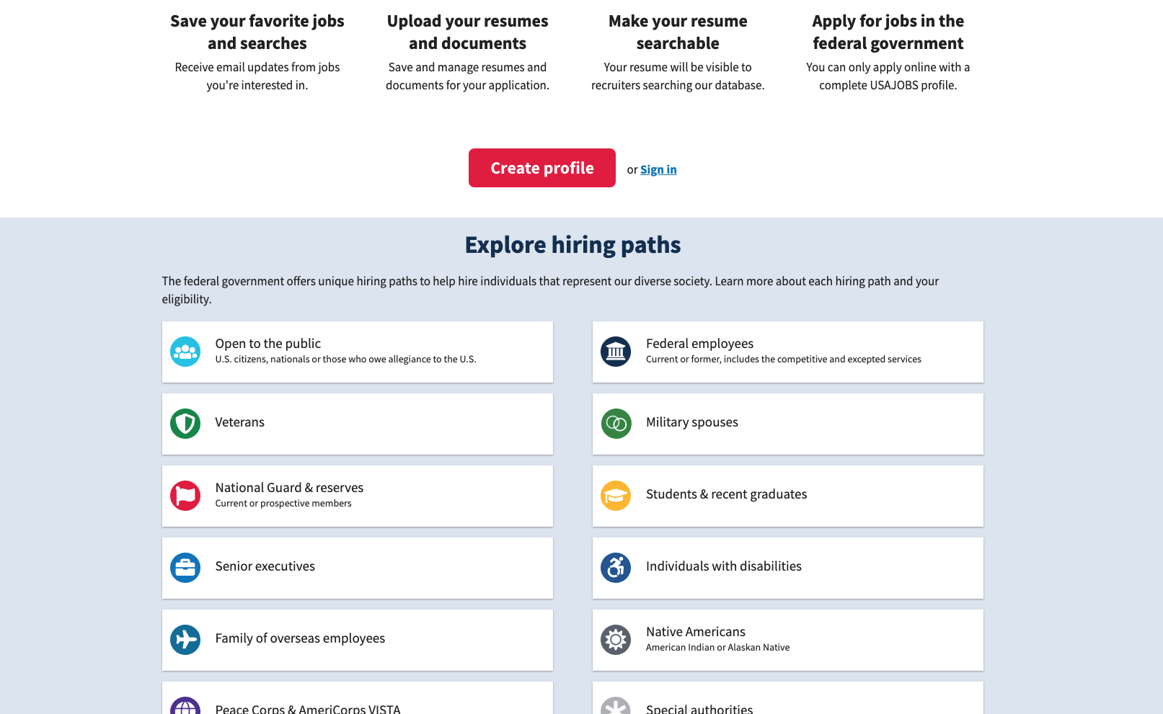
Examples of logged-out vs logged-in homepages
Research Findings
Two screenshots comparing USAJOBS.gov before and after logging in. The logged-out state offers search at the top, followed by a large banner with calls to action to create a profile, learn about the process and explore jobs and hiring paths. The logged-in state is completely different, with a personalization navigation at the top, hidden search, and a dashboard featuring application focused tasks.

Slide 20
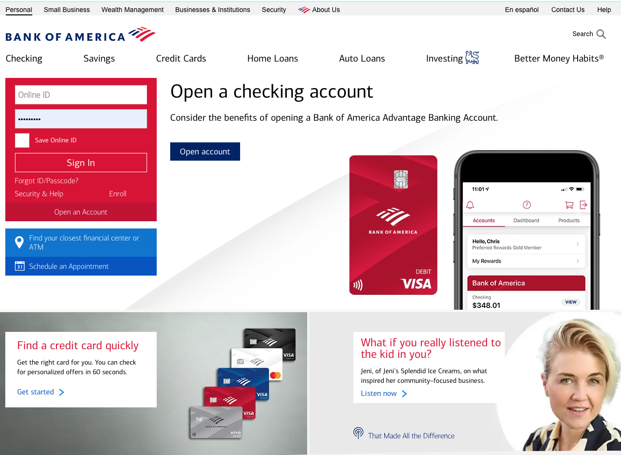
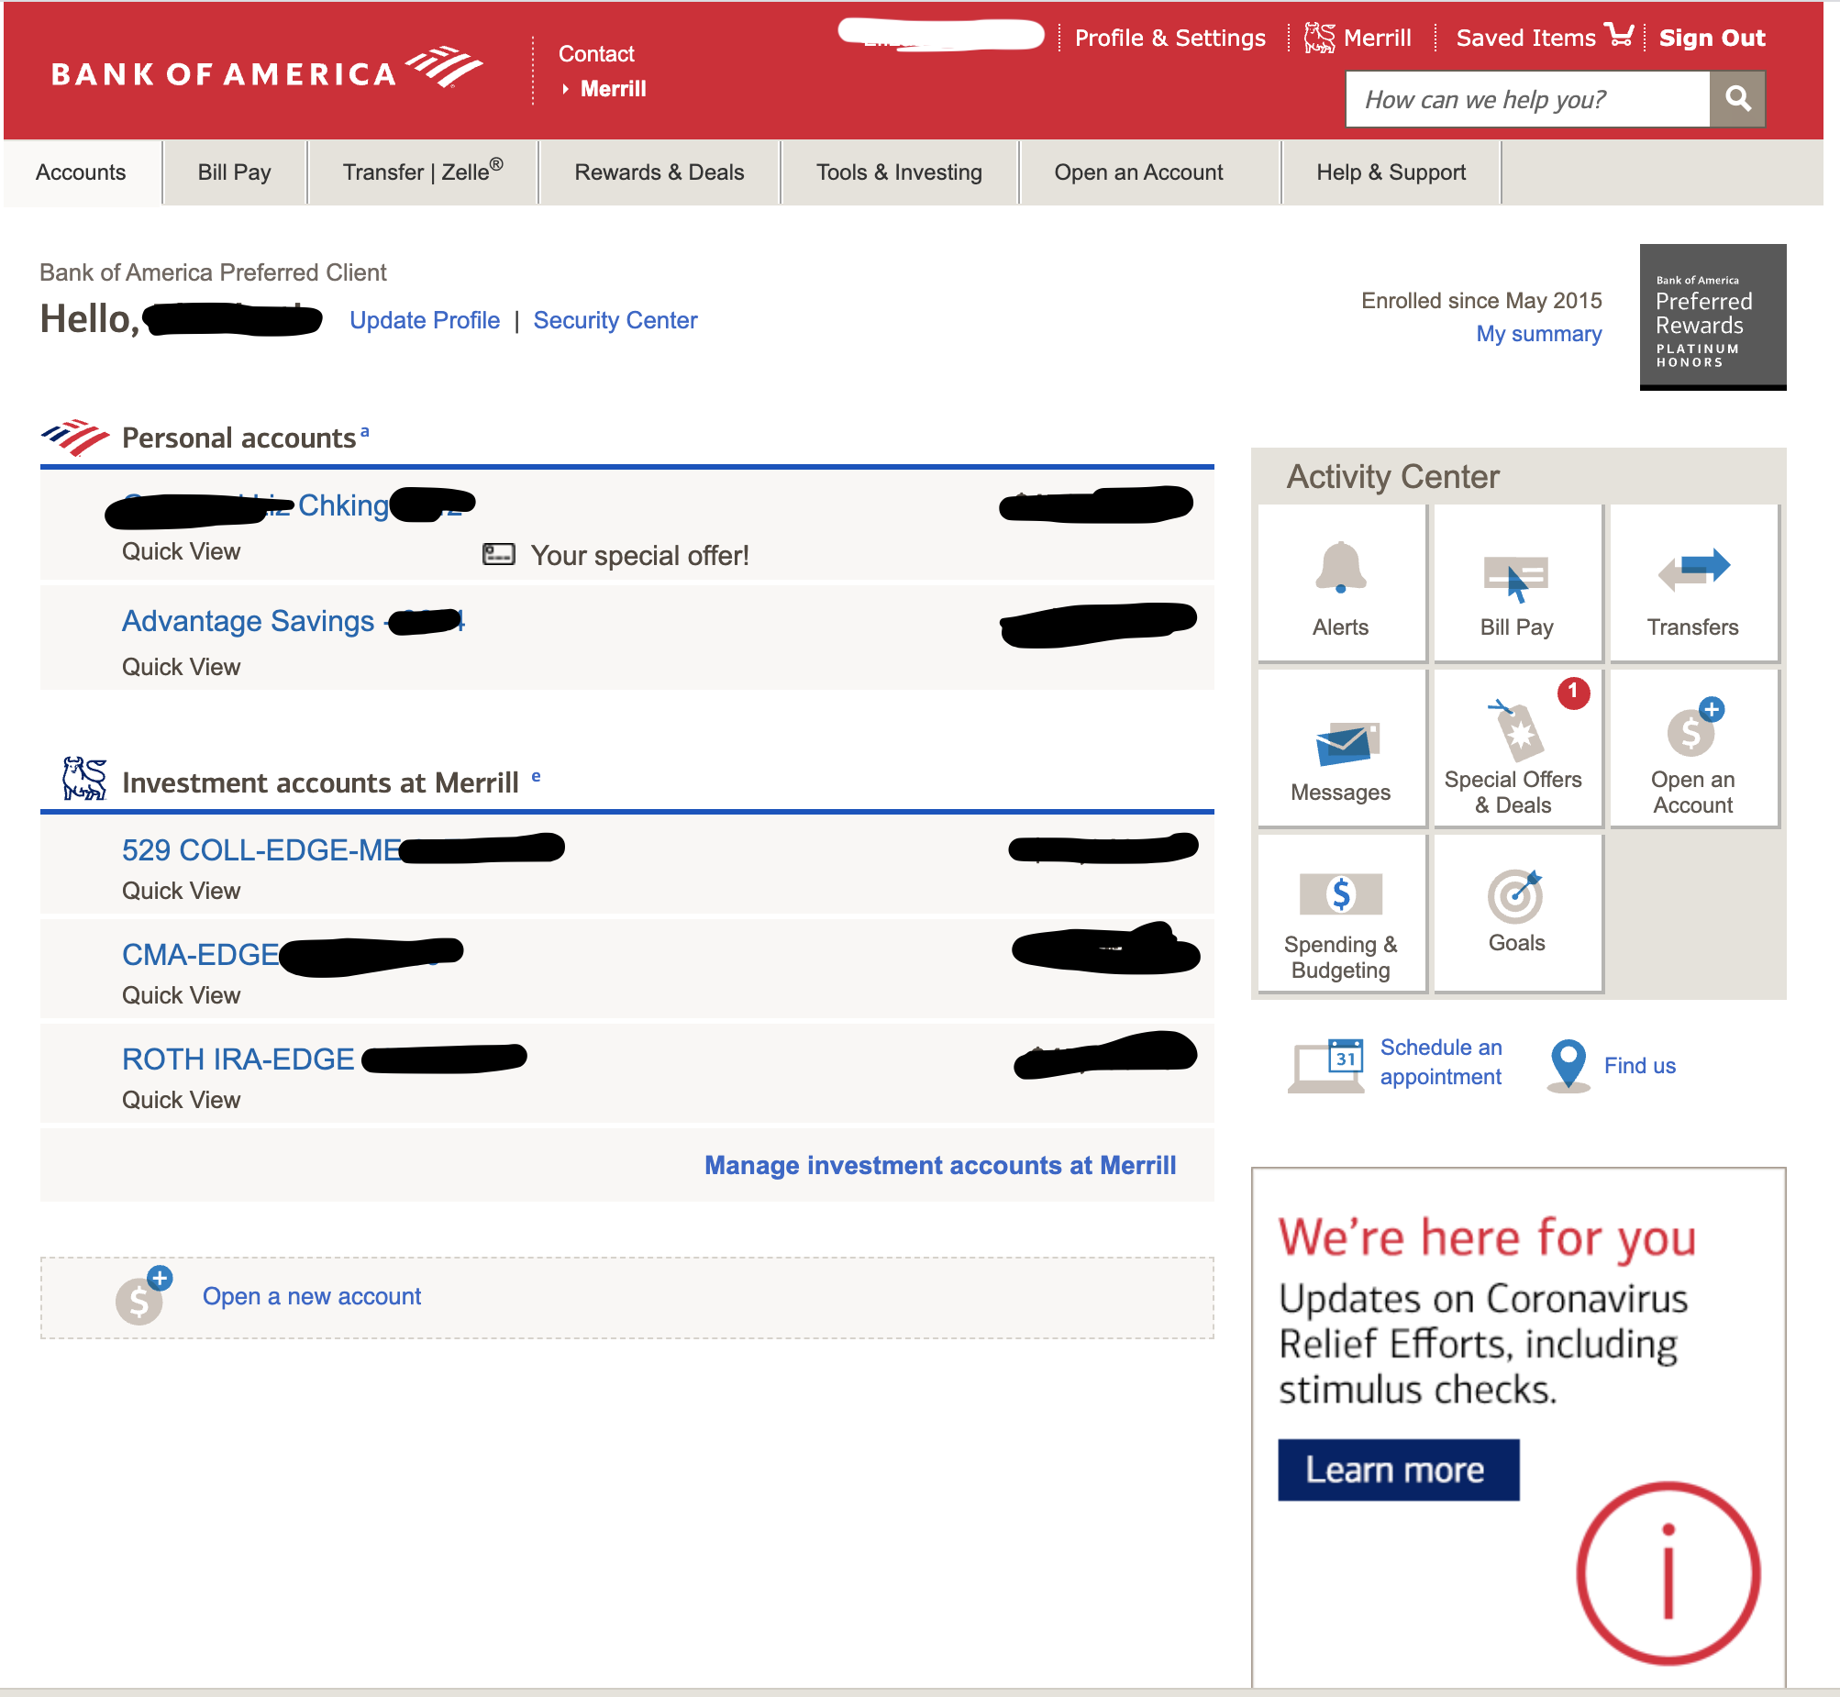
Examples of logged-out vs logged-in homepages
Two screenshots comparing Bank of America’s website before and after logging in. The logged-out state has two different navigation menus, one for banking type and one for products. It prominently features a sign in form and large calls to action to engage with banking products. The logged-in state is completely different, with a personalization navigation at the top, a dashboard featuring account management.
Research Findings

Slide 21
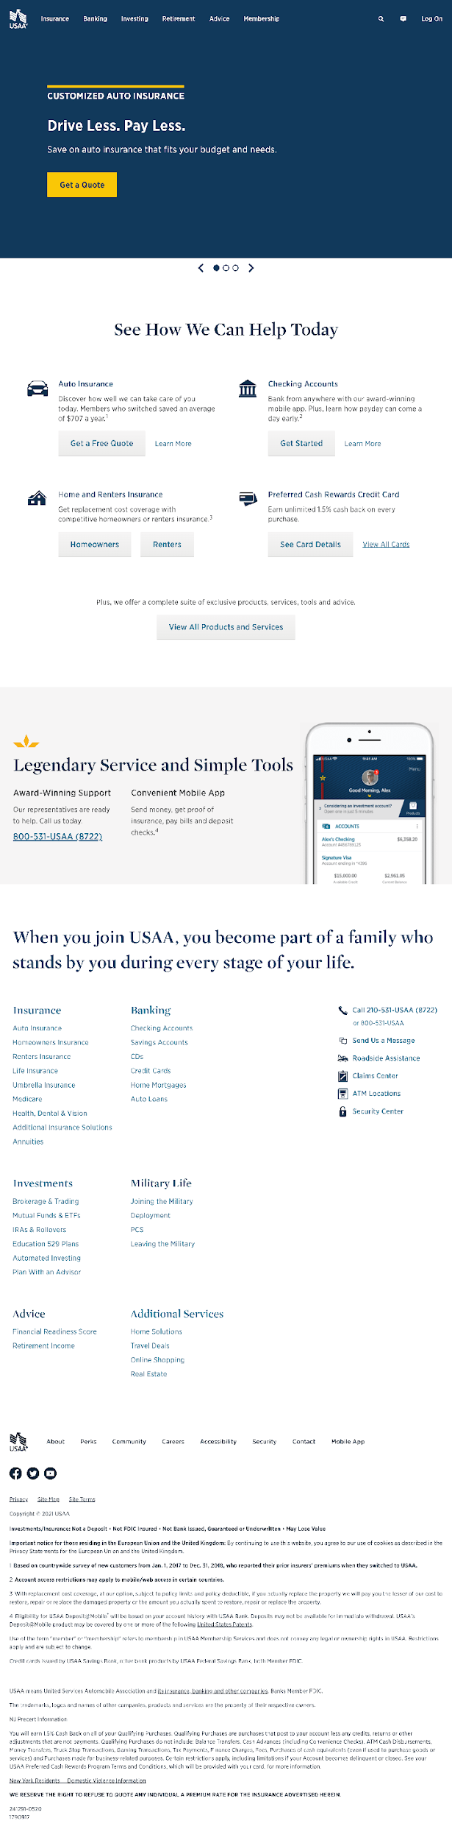
Examples of logged-out vs logged-in homepages
Research Findings
Two screenshots comparing USAA’s website before and after logging in. The top portion of logged-out state features a slideshow with different product information, followed by links under a heading reading “See how we can help today”. The logged-in state is completely different, with a personalization navigation at the top, customization options, and a dashboard focused on account management.

Slide 22
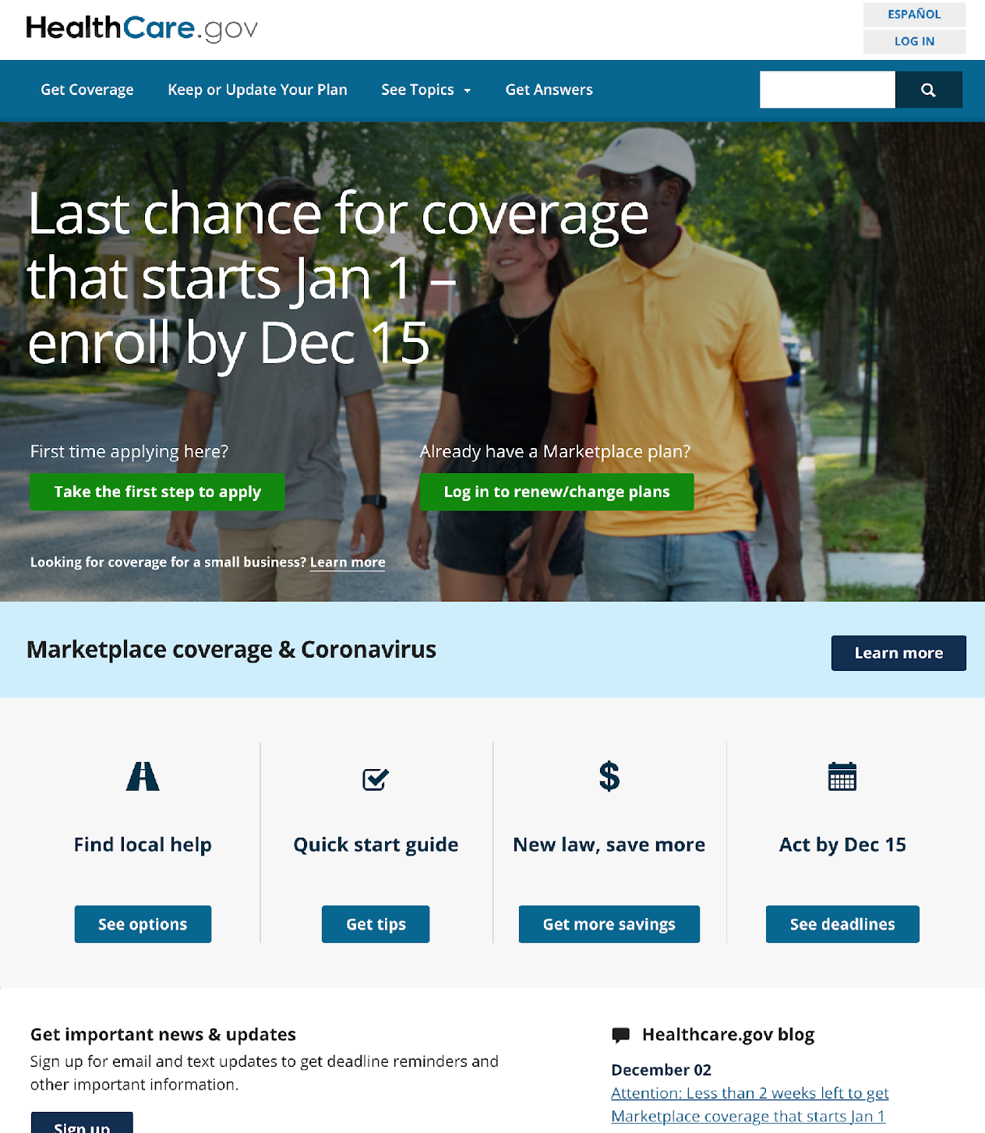
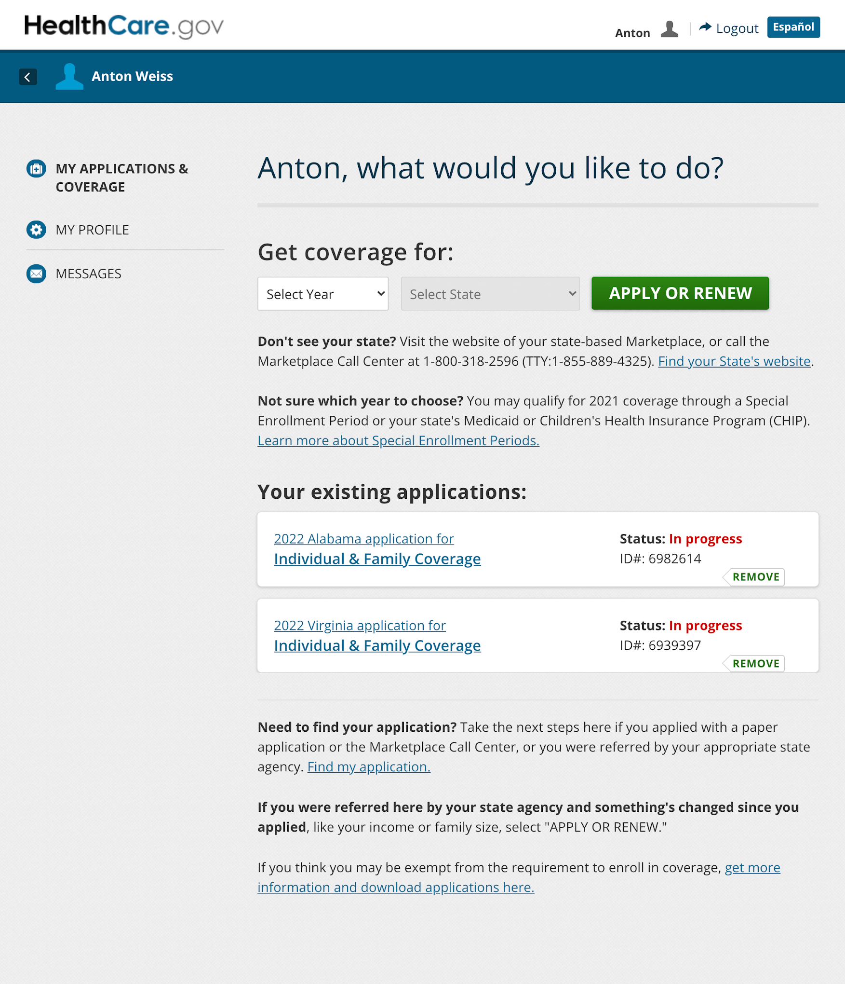
Examples of logged-out vs logged-in homepages
Research Findings
Two screenshots comparing Heathcare.gov before and after logging in. The top portion of logged-out state features a navigation menu with 4 items, search, a large “Last chance for coverage heading” followed by two links; one to apply and one to log in. Under the heading, there are several links to get help, tips, and learn about the application process The logged-in state is completely different, with a personalized navigation to see applications, coverage, profile, and messages. The heading includes the user’s first name and asks “What would you like to do?”, and is followed by sections for getting coverage and managing existing applications.

Slide 23
Another key difference in the AE on VA.gov compared to other sites: the information architecture.
Research Findings
Another difference we noticed was in the information architecture after logging in – most sites had more distinct breakdown for personalized content at the main navigation level than we do on VA.gov. Of the 15 sites we reviewed:
7 had a navigation point with the label "Profile" in the authenticated main menu.
3 of these included an additional label to add more information about what lives in that section. Examples include "Profile and Settings" and "My profile & preferences"
3 others had a separate navigation point for settings and preferences.
Instead of "Profile", 8 used alternate labels such as "User settings" or "Personal information"
Most of the sites also had completely different navigation after logging in.

Slide 24
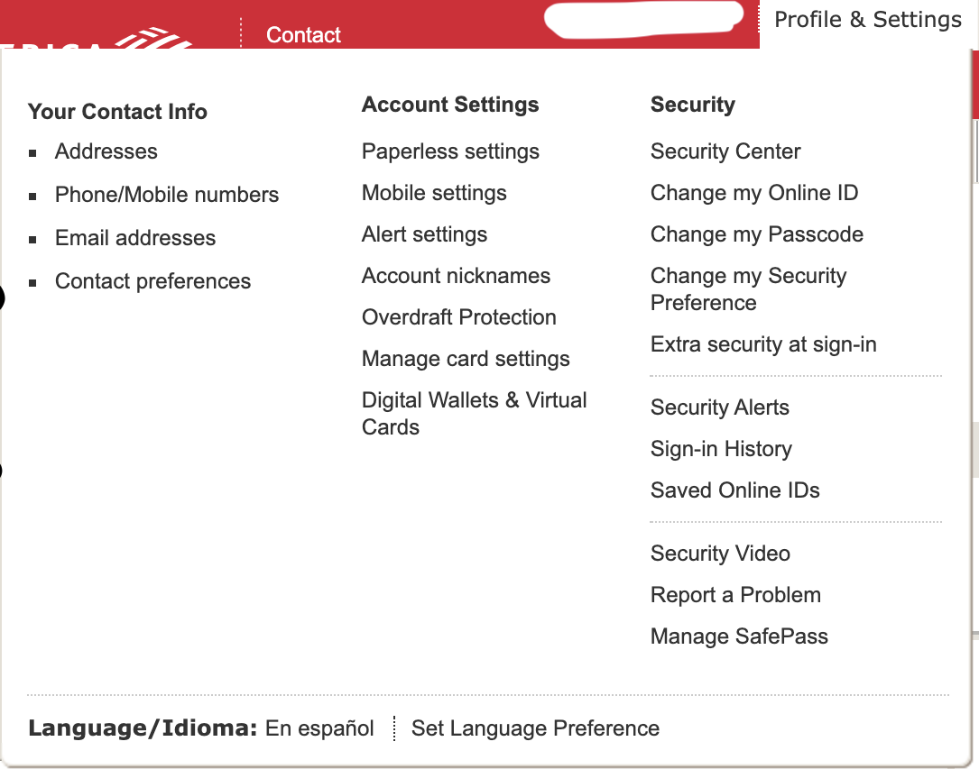
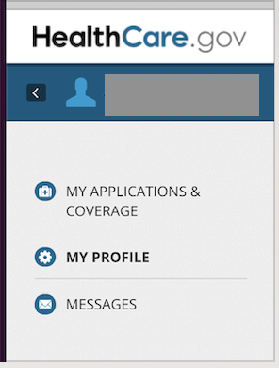
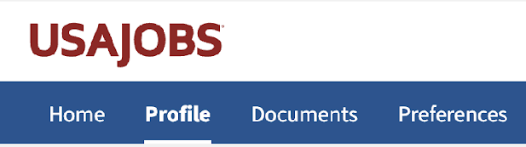
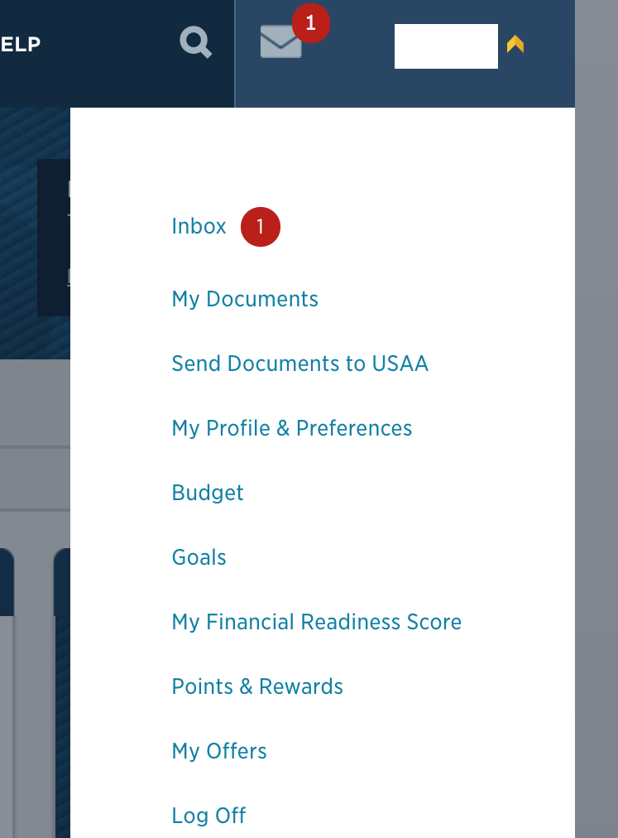
Examples of authenticated navigation show how profiles are structured.
Research Findings
USAJobs: Home, Profile, Documents, Preferences
Healthcare.gov: My applications & coverage, My profile, Messages
USAA: Inbox, My documents, Send Documents to USAA, My Profile & Preferences, Budget, Goals, My Financial Readiness Score, Points & Rewards, My Offers, Log Off
Bank of America: 4 sections under a Profile & Settings menu
Your contact info, Account Settings, Security, Language
Each section sub-navigation containing between 2-12 links

Slide 25
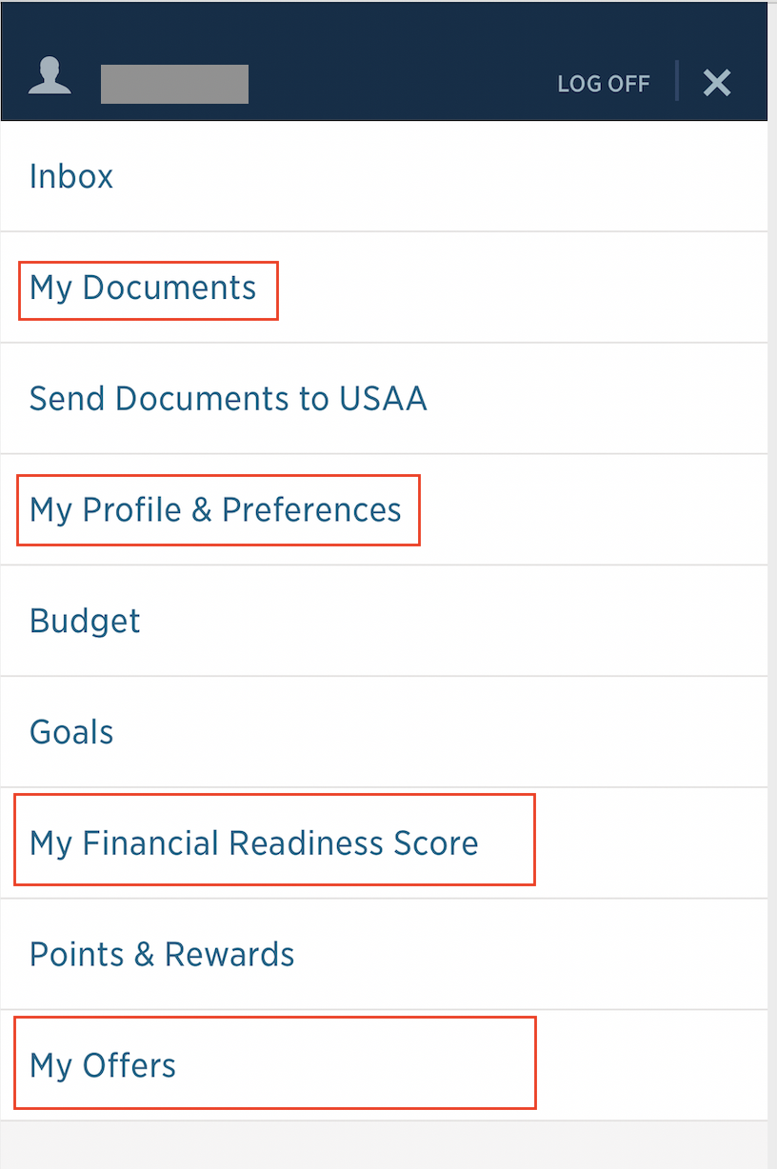
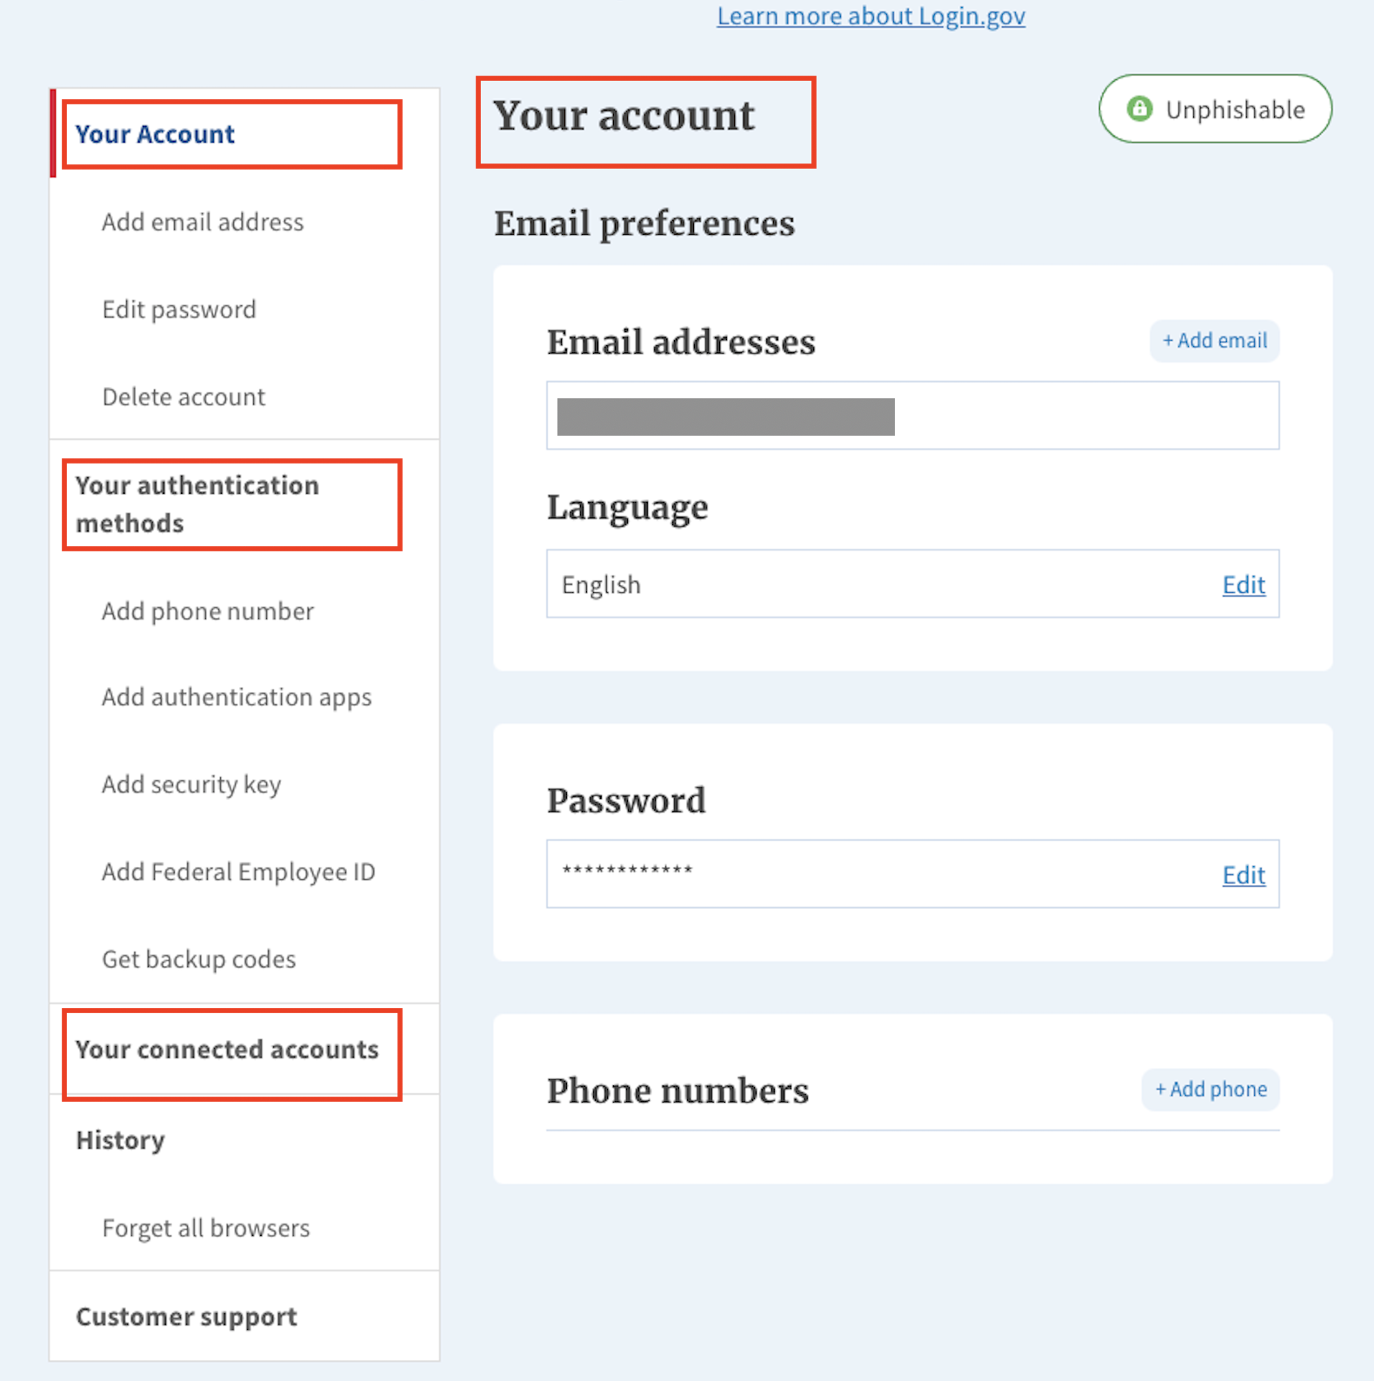
There isn't a clear best practice or trend for using "My" or "Your" in a personalized experience.
Research Findings
Of the 15 sites we reviewed:
3 use "My"
4 use "Your"
2 mixed the terms, using"My" in navigation points, and "Your" for section labels in the page body
6 didn't include either one, or any other variation
USAA (left) uses "My" in their navigation; Login.gov (right) uses "Your".

Slide 26
2. Profile

Slide 27
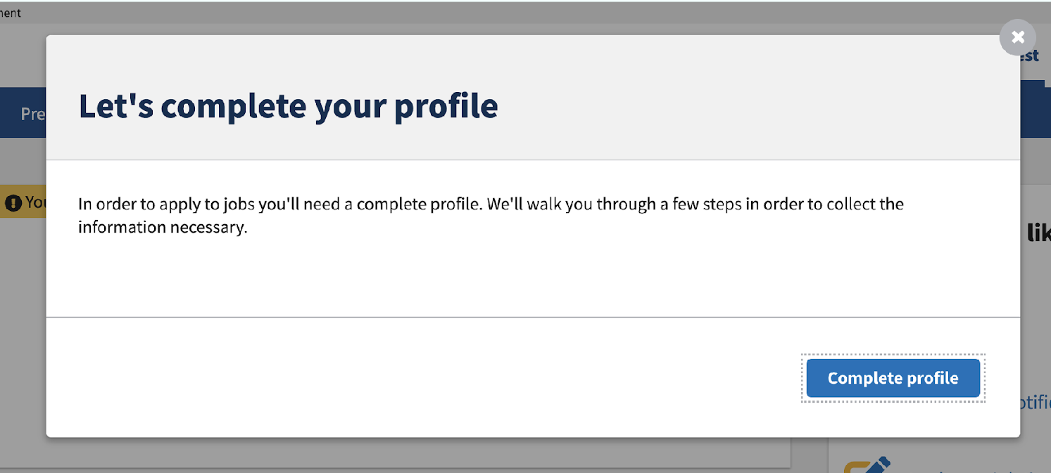
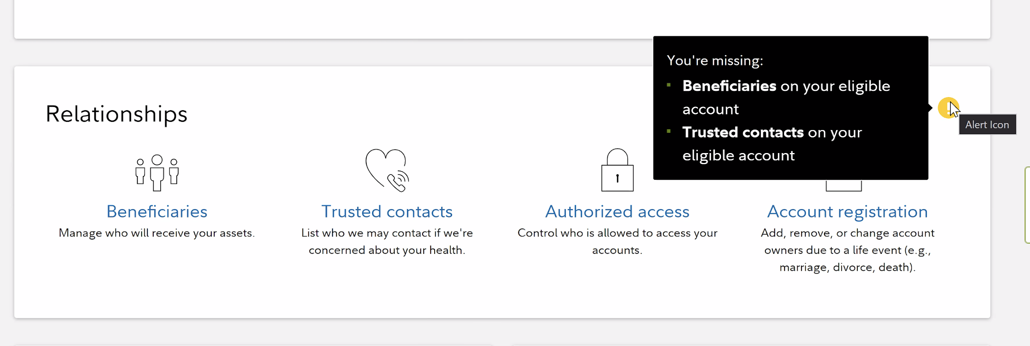
Interrupt modals and notifications are common approaches to encouraging people to complete their profile information.
Research Findings
8 of the 15 sites we visited had a UX to encourage profile completeness. The approach was varied across the sites, from a small warning icon next to missing information to redirecting users to a full page or modal dedicated to providing missing information.
Almost all allowed users to proceed onto other tasks by closing notifications or choosing a "remind me later" option.
Screenshot of modal with heading that reads “Let’s complete your profile”
Screenshot of tooltip containing a list of missing information from the Relationships section of a user’s profile

Slide 28
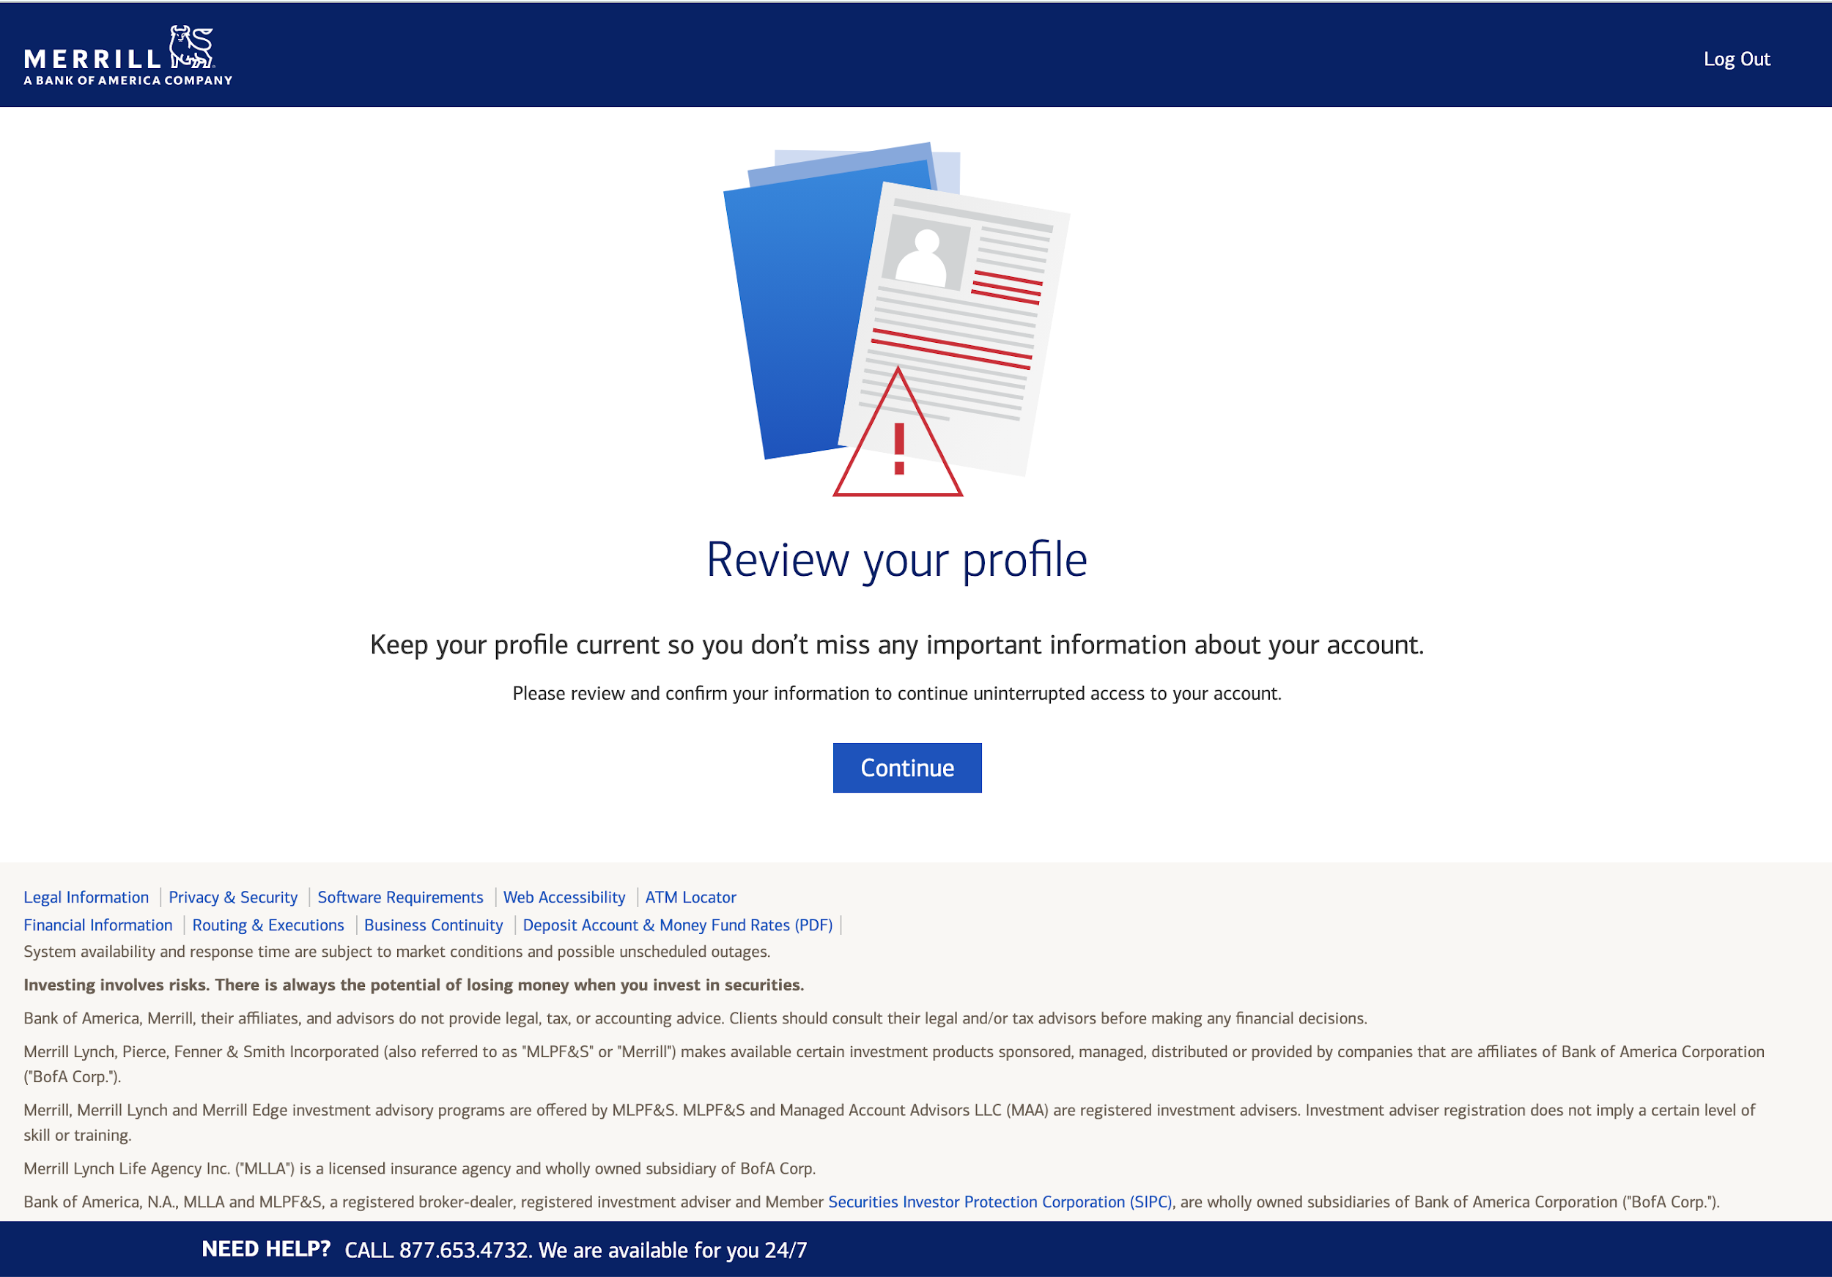
Example of site takeover to encourage profile completeness
Research Findings

Slide 29
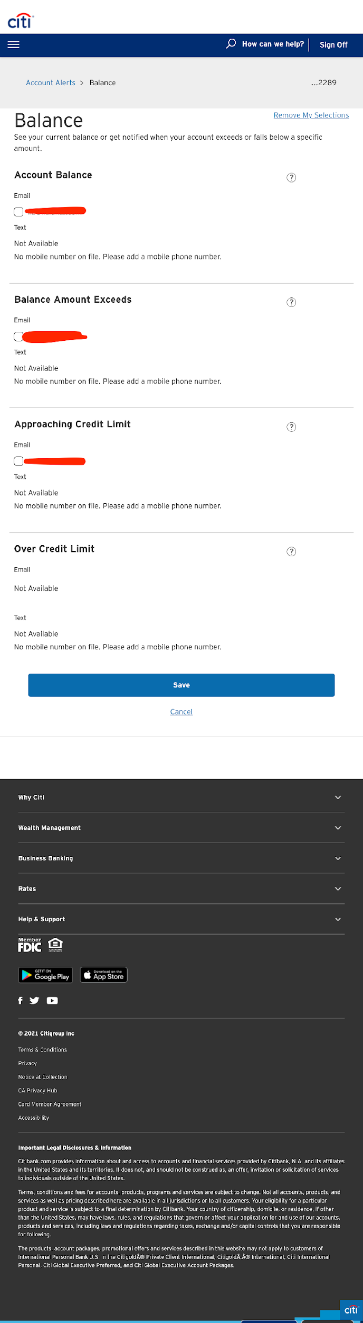
Example of site encouraging profile completeness
Research Findings
Citicards lets the user know the text notification is not available because the user doesn’t have a mobile number on file. However, this falls short because they do not provide an easy way to add one.

Slide 30
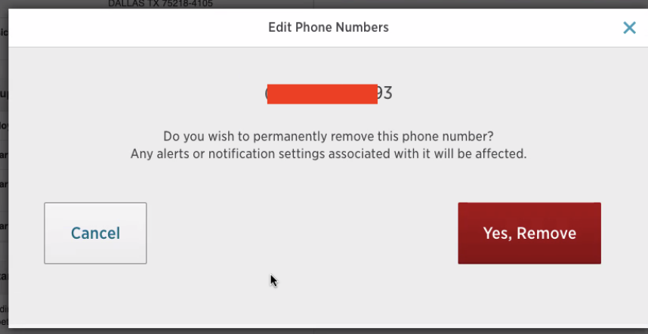
Most sites don't allow people to remove primary contact information from their profile.
Research Findings
Primary contact information (email, phone, address, etc) couldn't be removed from the profile on 11 of the sites we looked at. 3 of those sites did allow removal of secondary contact information, such as a second phone number.
Recently, VA.gov exposed the remove functionality by moving it outside of edit mode, so we wanted to see how that compared to other sites. Of the sites we looked at that allow removal of contact information:
2 had the remove functionality next to an edit button.
3 had the remove functionality nested within the edit function.
All showed something similar to VA.gov's "Are you sure?" modal, explaining the consequences of the removal action.

Slide 31
The sections of the VA.gov profile are well aligned with other sites.
Research Findings
VA.gov's profile has 4 sections that are aligned with sites we visited:
Account security
Personal information
Contact information
Notification settings
Terminology and IA was slightly different in some cases (e.g. "Security settings" instead of "Account security", or "Personal and contact information in one section"), but not so different that changes are recommended. Generally, these are sections people would expect to find in a modern, personalized experience.
Some sites had a "Documents" section in their personalized section; this is the only section we identified that could be a useful addition to the VA.gov profile.

Slide 32
3. GOV.UK

Slide 33
GOV.UK is in early stages of personalized user experience.
Research Findings
Our VA.gov team frequently looks to GOV.UK for inspiration, so we wanted to learn more about how they approach personalization. Their Accounts team is in the beginning stages of that work, which includes:
A "Save your work and return" flow for applications
Letting people sign up for notifications on certain pages (e.g. COVID travel updates)
Running experiments to refine technical execution by putting work-in-progress on staging and only testing internally or with a private, invite-only beta testing group.
Since personal data comes up, they frequently do audio-only calls and monitor analytics during testing to track activity
Exploring how they might reflect the fact that some content is relevant and some isn't (e.g. if you live in Scotland vs. England)
Exploring how to handle accounts across government agencies.

Slide 34
Recommendations

Slide 35
Recommendations
Personalization and profile comparative analysis | December 2021
Continue working toward making My VA the logged-in homepage.​
Reevaluate the way we encourage people to complete their profile information.​
As a team, let's consider and discuss questions about personalization and civic services.​
Incorporate transparency into personalization.​

Slide 36
Continue working toward making My VA the logged-in homepage.
Recommendations
The goals we've outlined for My VA are aligned with Veteran's needs, and modern public and private sector site experiences. We should continue working toward the goal of providing Veterans with a task-based, personalized landing page upon logging in.

Slide 37
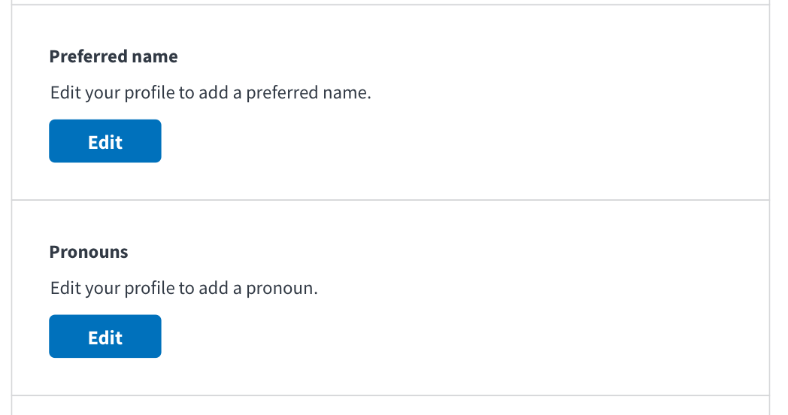
Reevaluate the way we encourage people to complete their profile information.
Recommendations
To start this process, we'll need to consider how complete profile information can improve a Veteran's experience with VA, and how that aligns with OCTO's North Star goals.
Our current approach is light, with a simple "Edit your profile to add a [missing data]". While this has the benefit of being unobtrusive, it's easy to skip over it. We can use design and content to make missing information clearer and better communicate the value to Veterans of adding missing information.
VA.gov profile blank state, December 2021

Slide 38
As a team, let's consider and discuss questions about personalization and civic services.
Recommendations
Personalization is a sensitive and important aspect of the Veteran experience. When it's done well, it can foster trust and greatly improve Veteran self-service. As a team, we have an opportunity to make a dedicated effort for learning more about the work we're doing. This would be particularly valuable when kicking off larger initiatives.
For example, here are some thought provoking questions we encountered in our research:
What are the ethics in government delivering services based on predicting people’s needs?
Which information and services do Veterans actually need to live their lives better?
Is it acceptable if some people choose to opt-in to personalized services, and everyone else gets the standard version? Would this lead to two-tier public services? (And would it matter if it did?)
If it's not appropriate for product teams to spend time on this directly, it could still be beneficial for teams to hear how OCTO considers these types of questions as they establish business objectives.

Slide 39
Incorporate transparency into personalization.
Recommendations
In order to build and maintain trust, we should be transparent about how we know things about Veterans and how their data is being used. It can feel creepy when websites seem to know things about you and it's not clear how they know that. And, it can feel invasive when websites ask for your information without making the reason for asking clear.
In our recent personal information update, we added an FAQ to let Veterans know why we're asking for this information. This is a good example of transparency and what we can continue to do moving forward. As we add roll out features related to personalization, we should ensure to get Veteran feedback to understand the level of transparency they expect and need to maintain trust in VA.

Slide 40
Appendix

Slide 41
Articles
5 things to think about when personalizing government digital services
Reimagine an age of more personalized services for citizens
Accenture's 2019 Tech Trends, Trend 2 "Get to Know Me" (page 29)
What if public services could be more like Amazon’s?
Creating a personalized, digital experience in government
Introducing GOV.uk accounts
Using accounts to personalize the experience on GOV.uk
How we designed the GOV.uk accounts trial
Five things we learned from researching the GOV.uk account

Slide 42
Documentation
Research plan

